Slide 1

TEAM NAME:VIJAY04
PACKAGES_USED:
1.KIVY
2.PYTEZOS
Github: IN4111
Web3 integration with Web2 Track-Fair Reselling Marketplace Using Tezos Technology.

Slide 2
HOW IT WORKS?
EACH TICKET HAS A SECRET TEXT/HASH
ON SUCCESSFUL PURCHASE ,RESELLER GET THE TICKET HASH OF THE TICKETS
THIS HASH IS THEN EVALUATED AND VERIFIED BY GOING THROUGH TICKET PURCHASE HISTORY, TO WHOM IT SOLD ,WHAT DATE SOLD AND SO ON.
RESELLERS CAN BE REMOVED FROM ACCESSING TICKETS

Slide 3
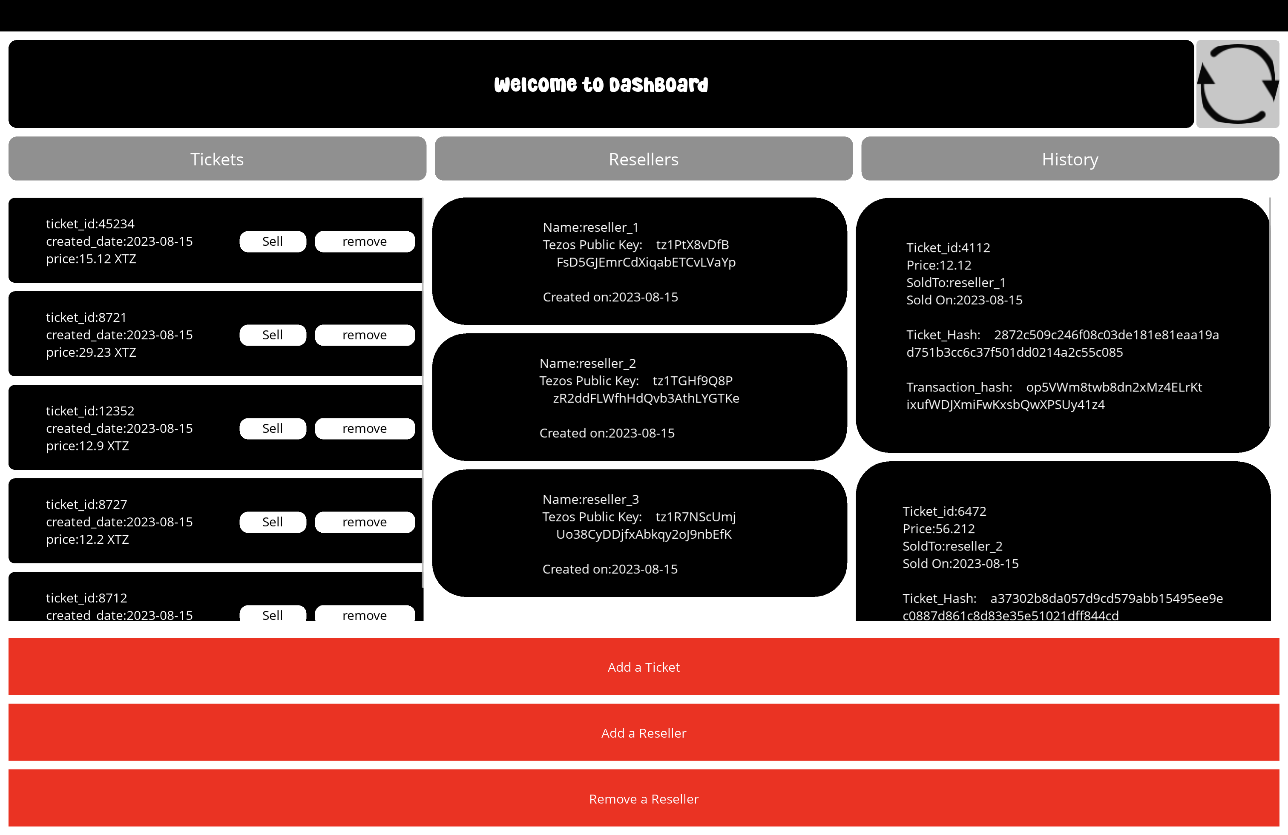
APP BUILD FOR ADMIN

Slide 4
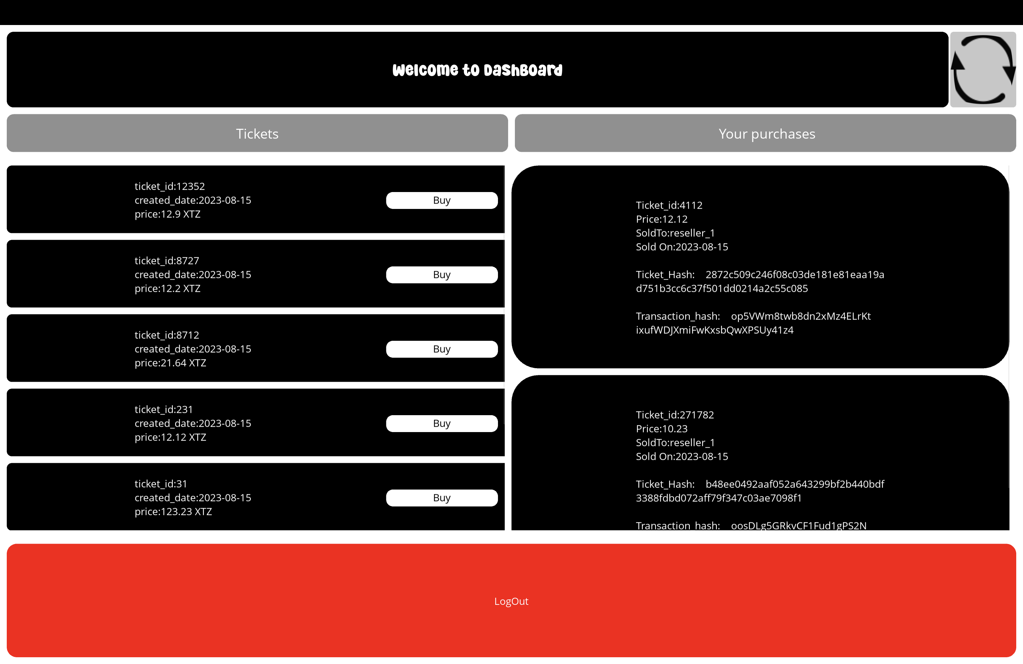
APP BUILD FOR RESELLERS

Slide 5
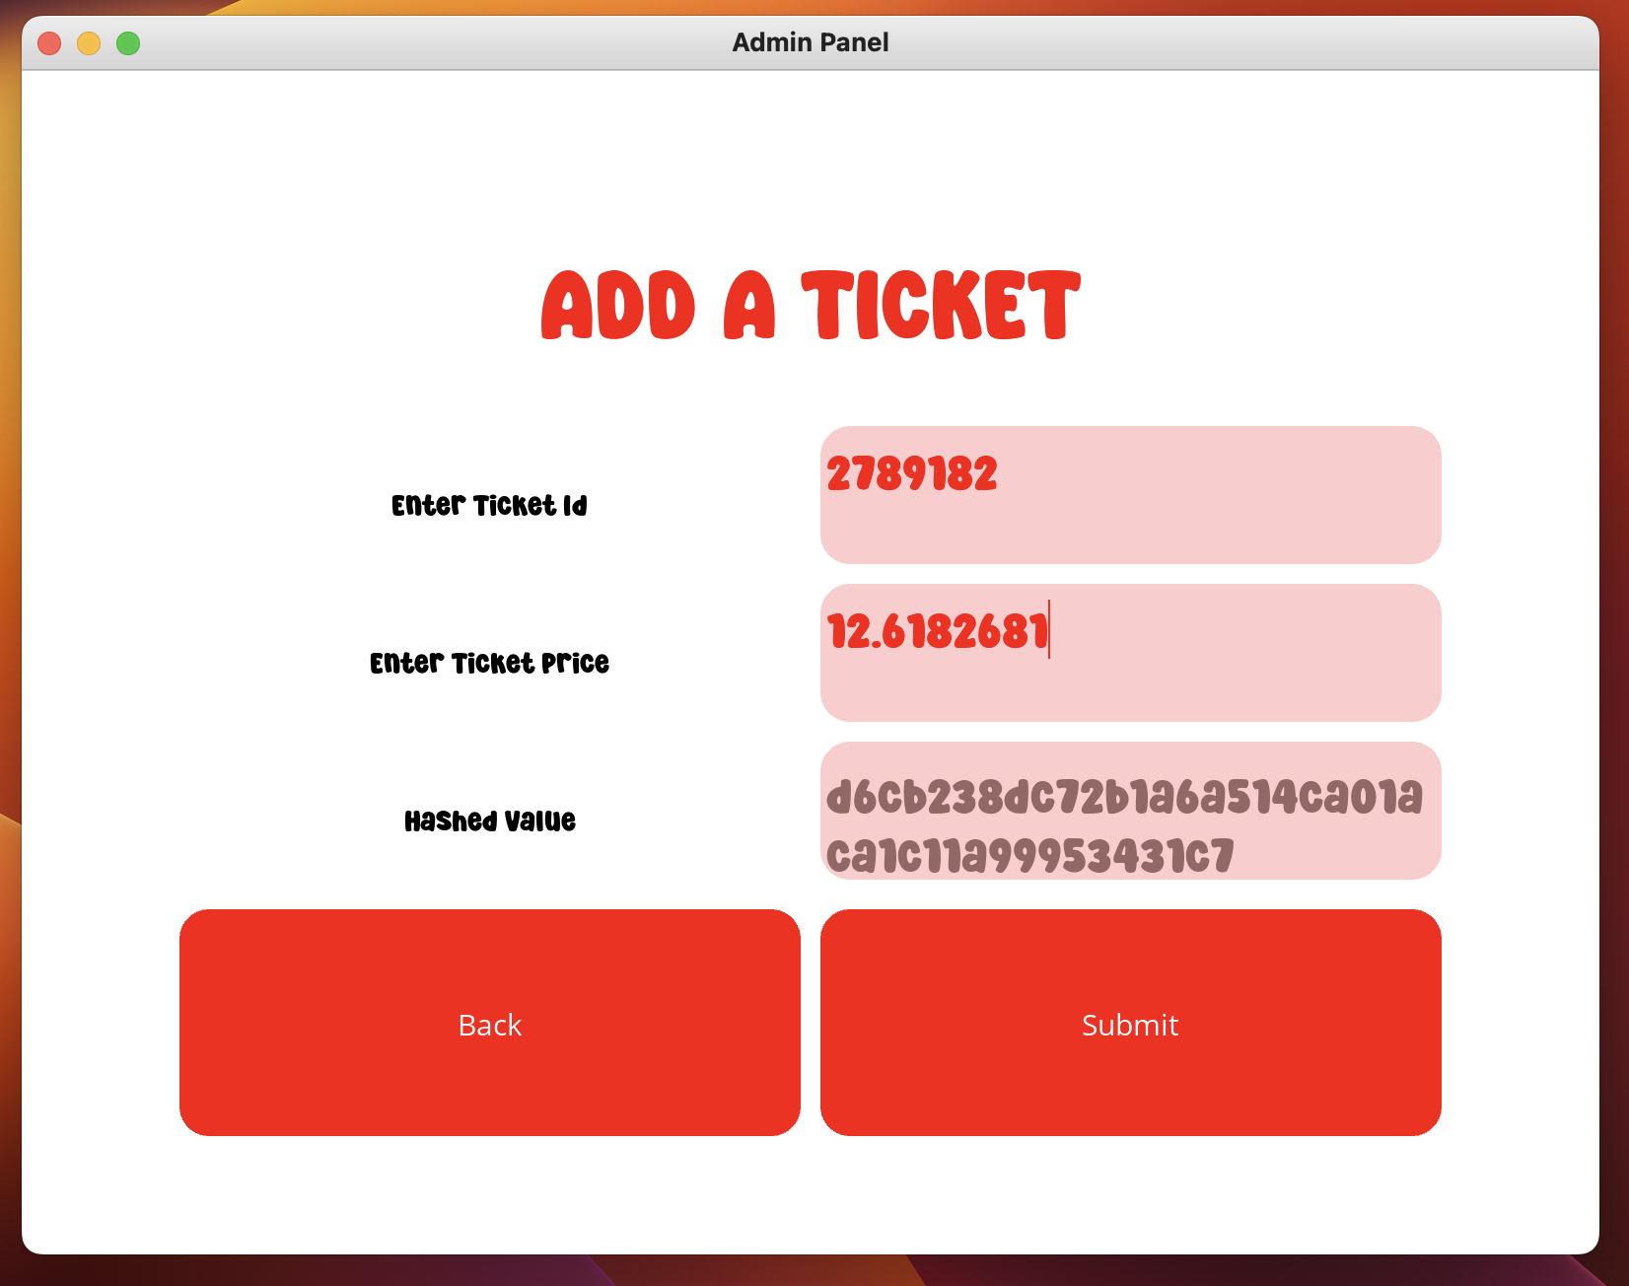
ADDING TICKETS:

Slide 6
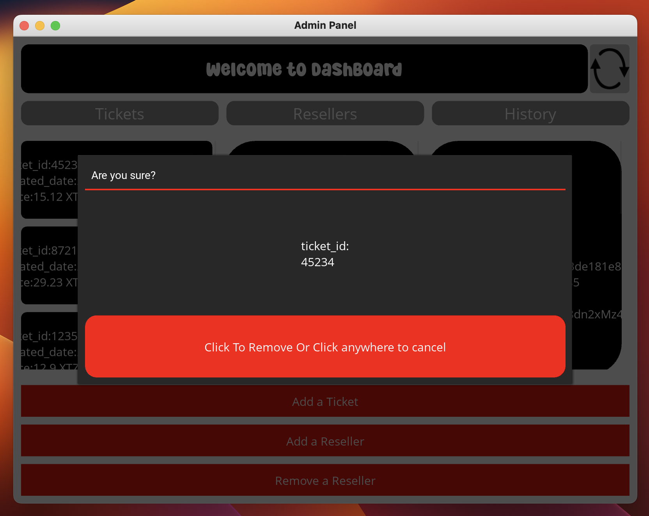
REMOVING A TICKET

Slide 7
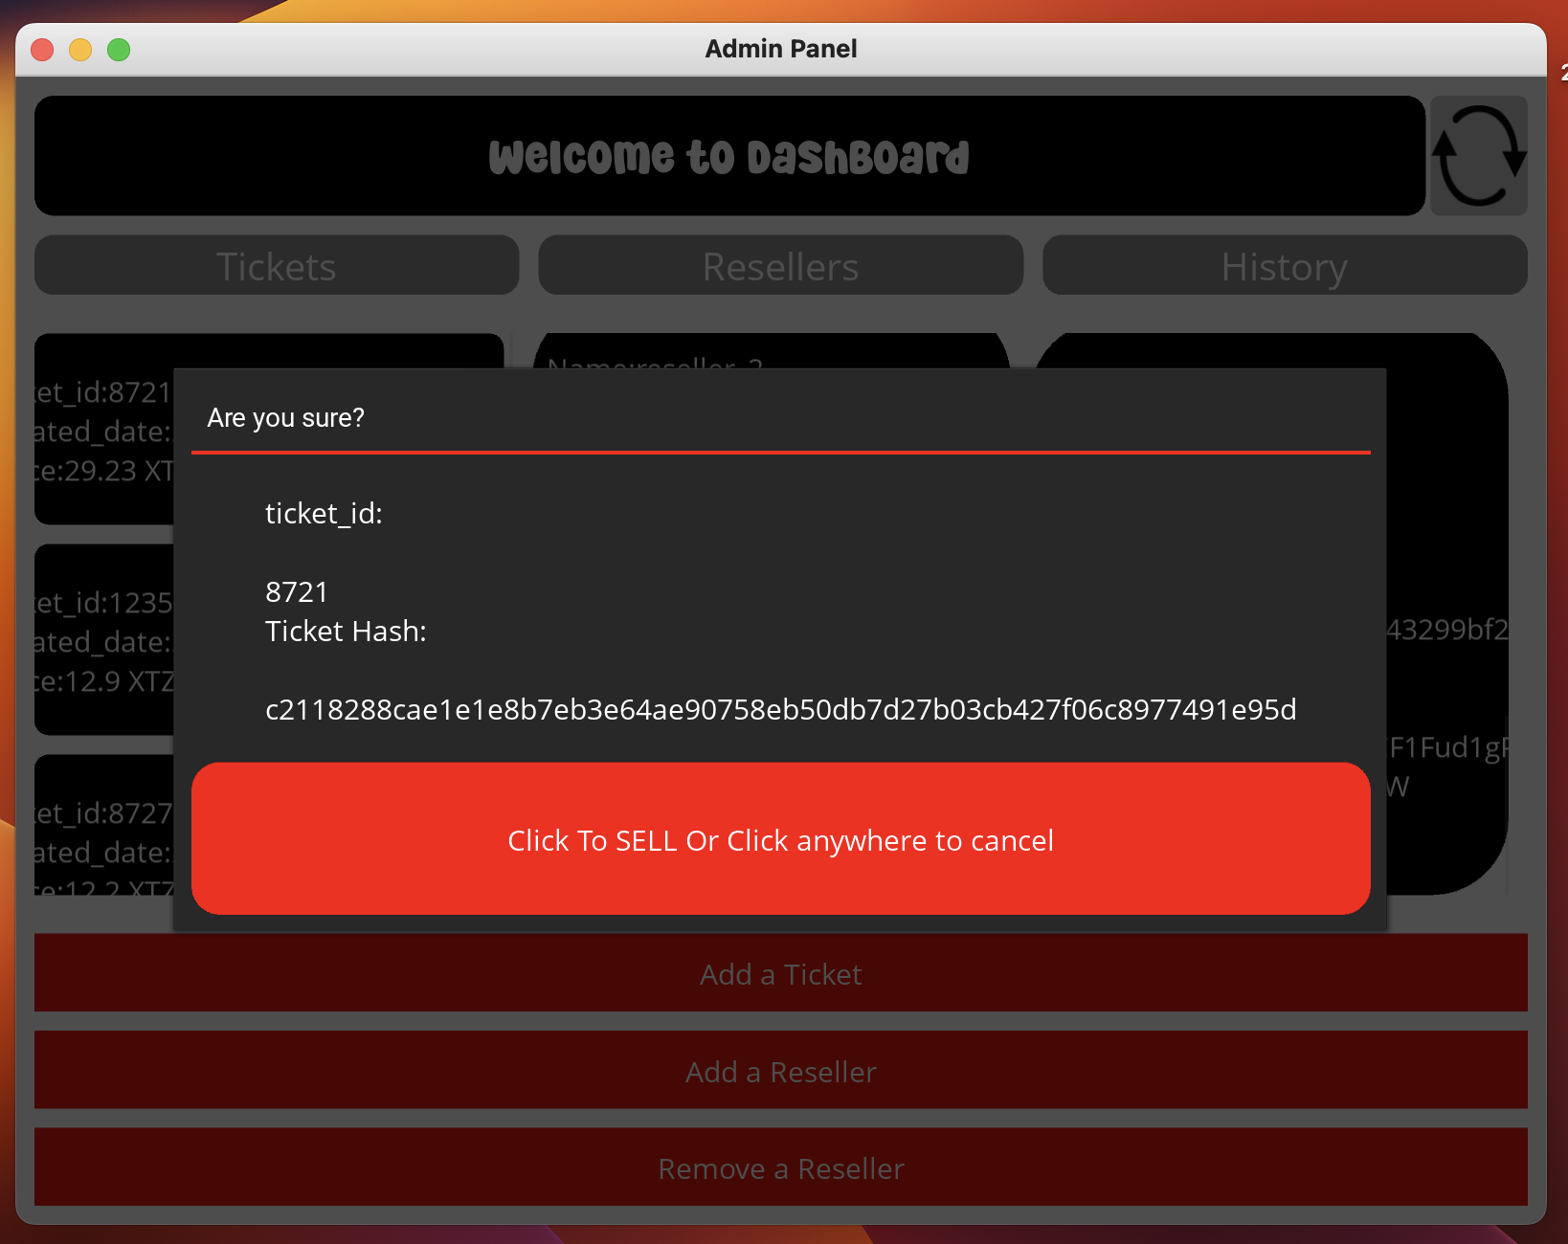
SELLING TICKETS IN LOCAL AND REMOVING FROM TICKETS

Slide 8
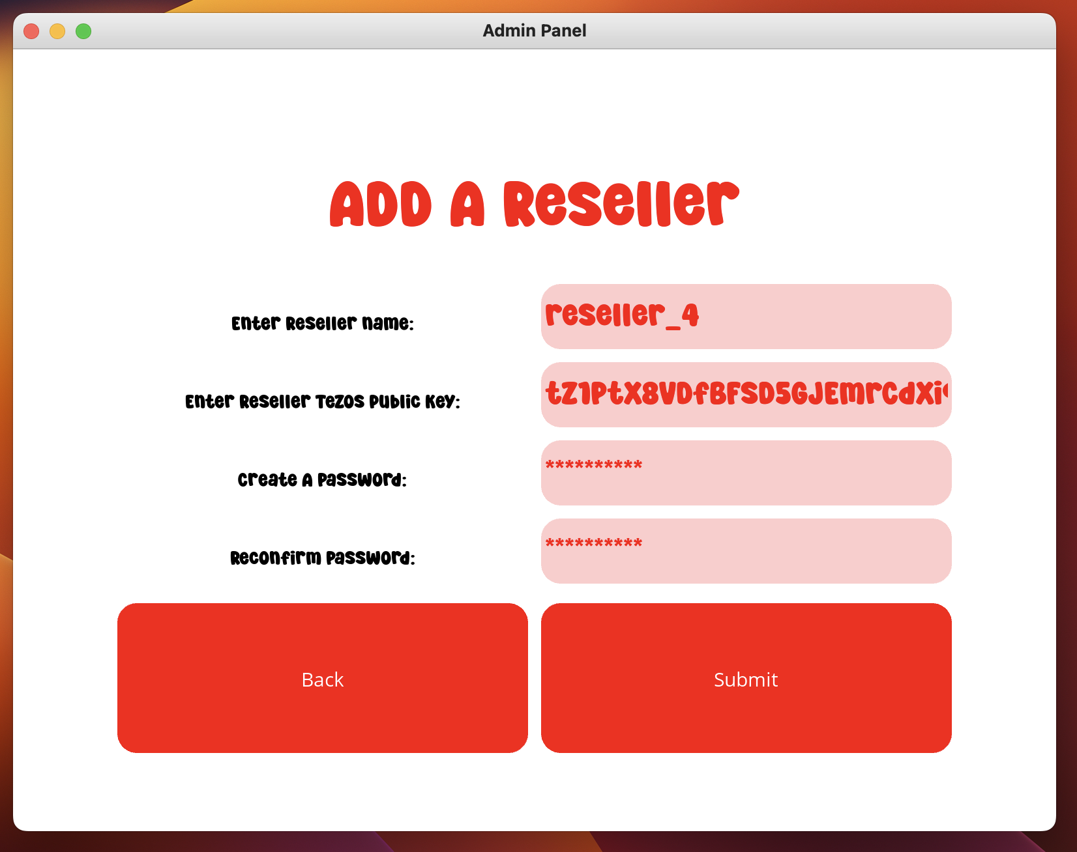
ADDING A RESELLER

Slide 9
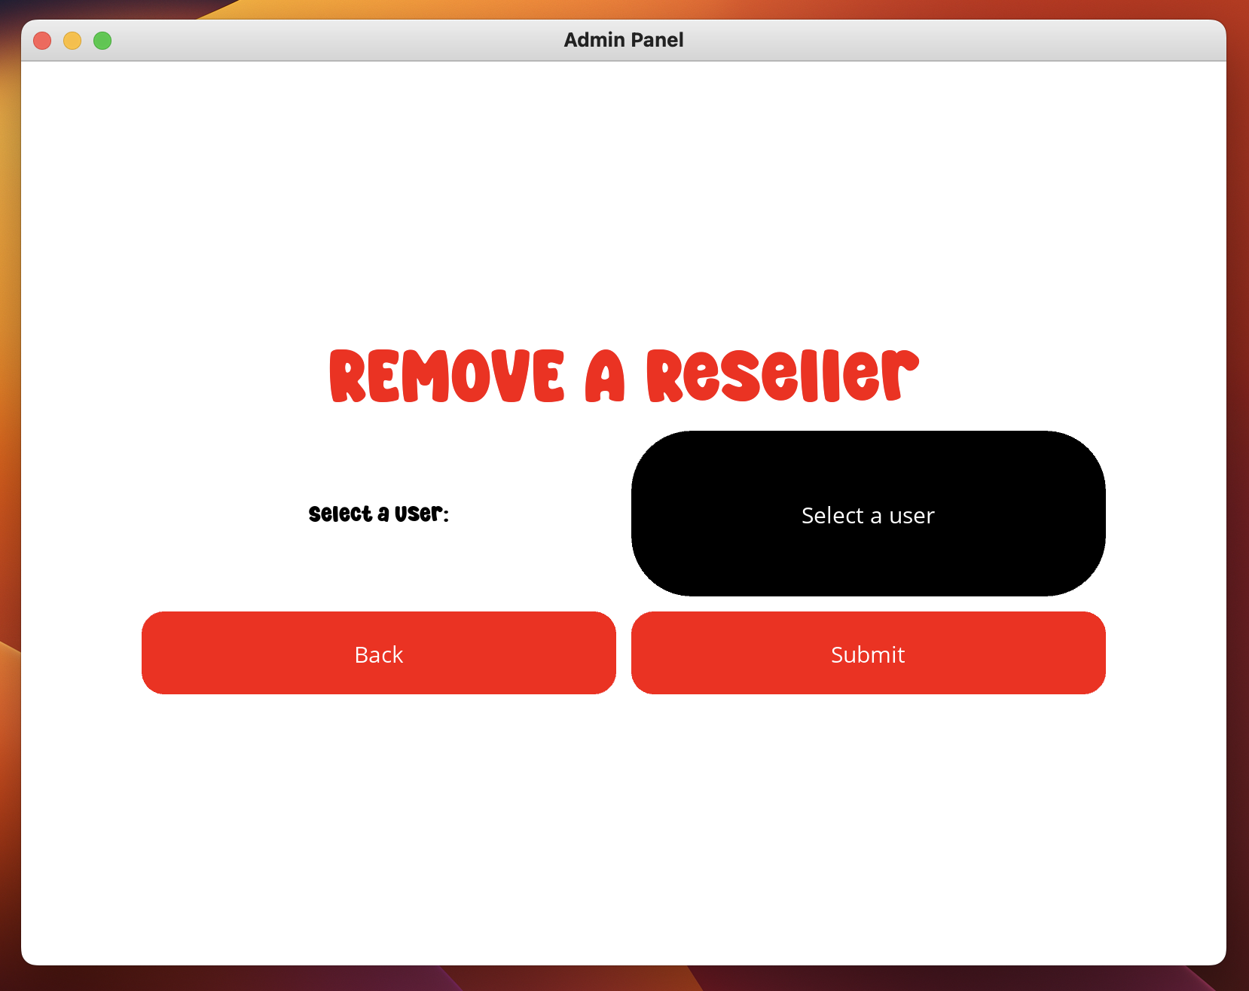
REMOVING A RESELLER

Slide 10
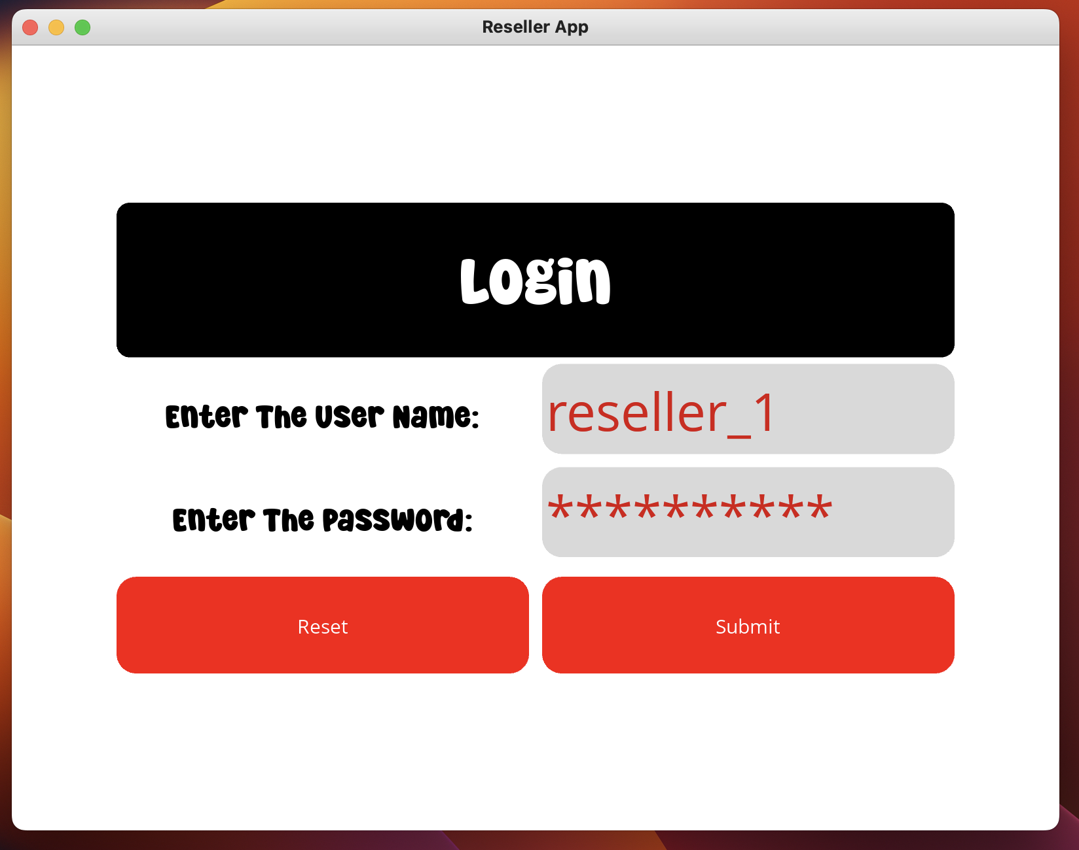
LOGIN IN (RESELLERS)

Slide 11
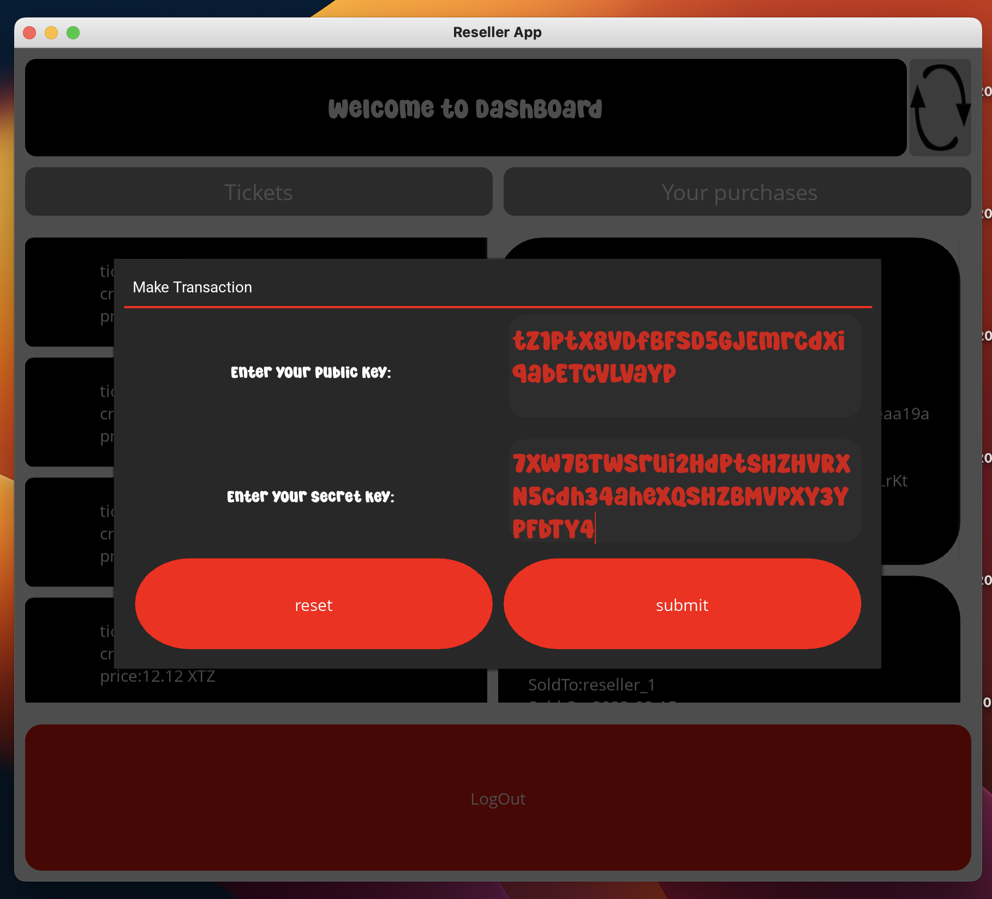
BUYING A TICKET (RESELLER)

Slide 12
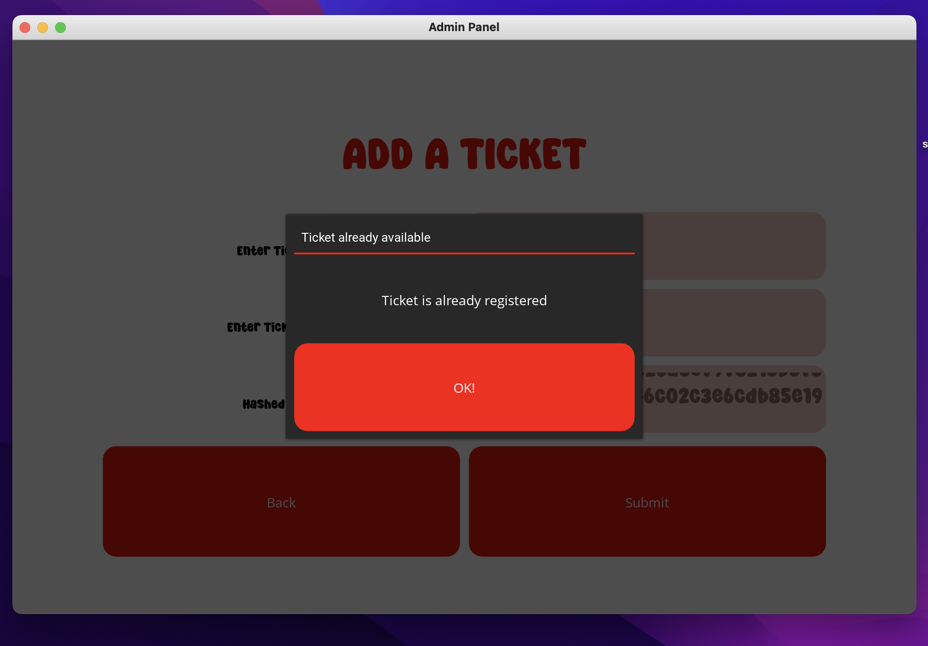
ERRORS HANDLING : DUPLICATE TICKETS

Slide 13
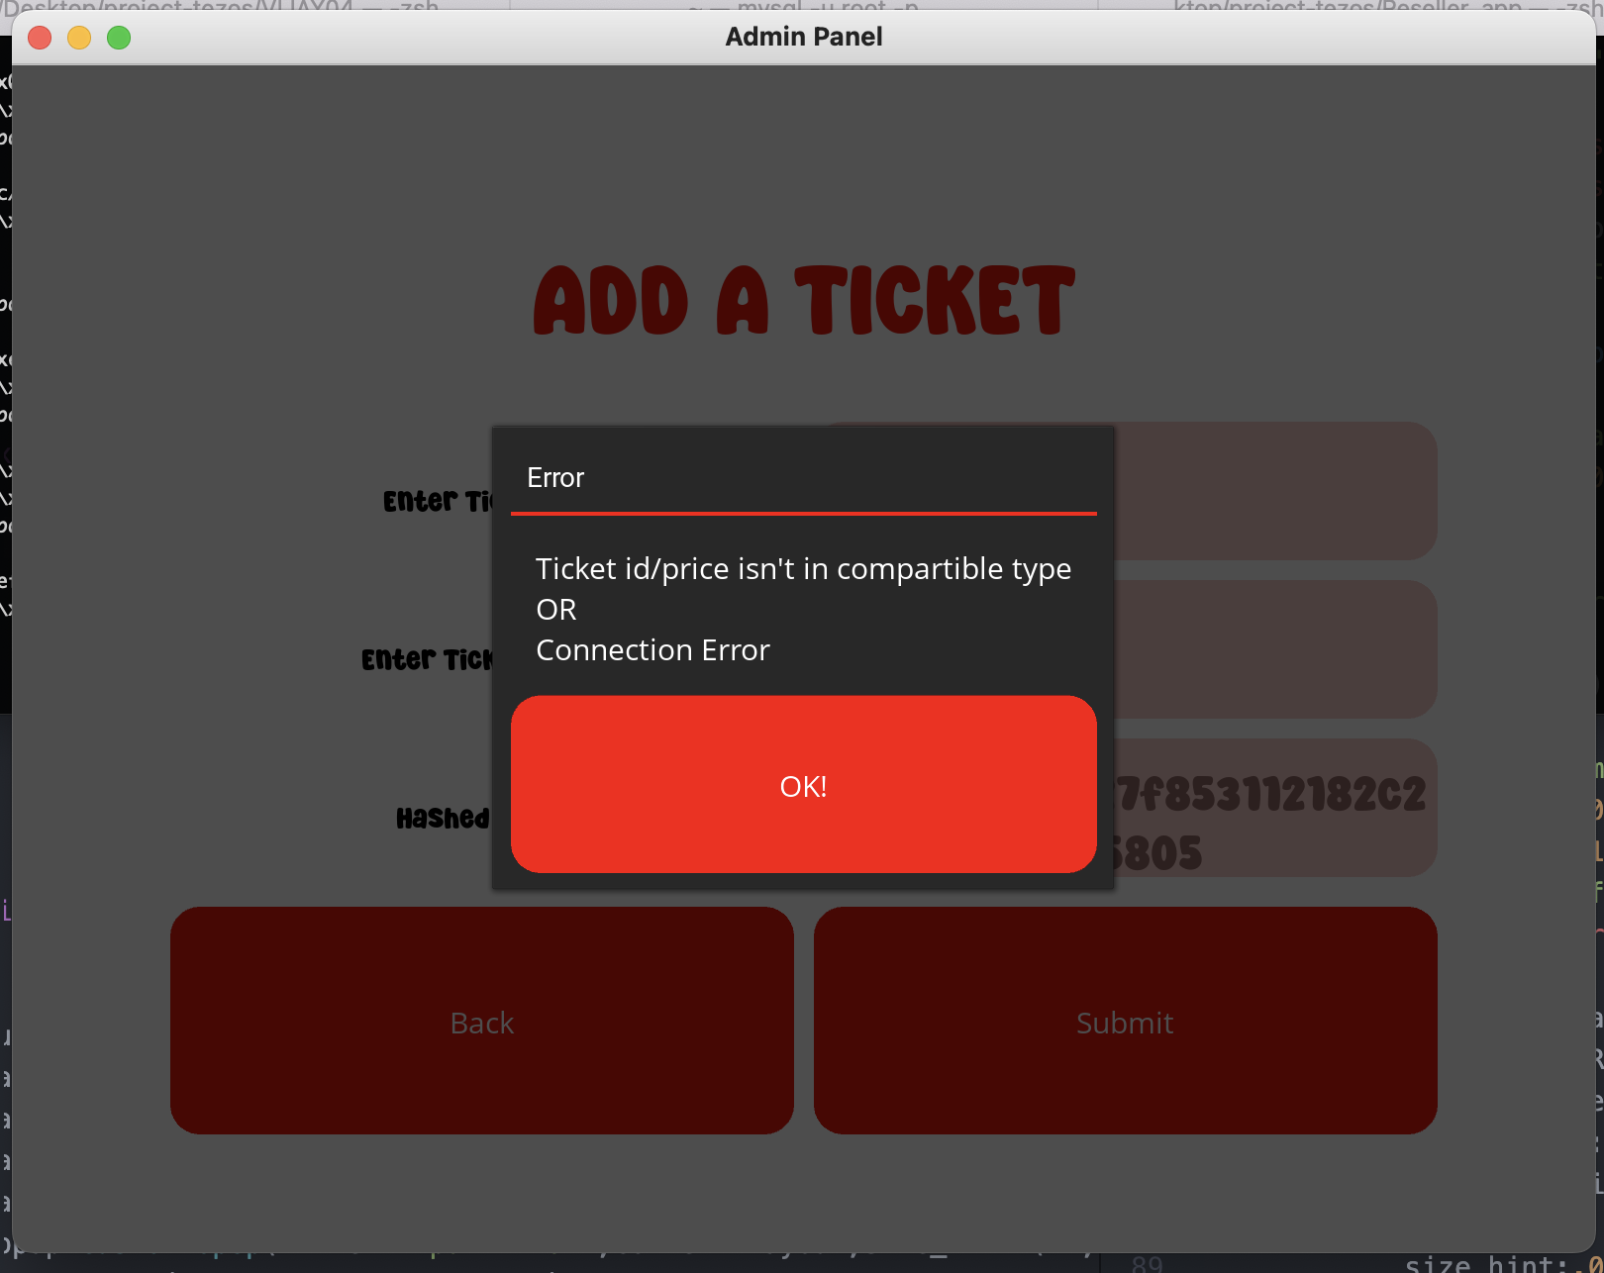
ERRORS HANDLING :NON-Compartible type

Slide 14
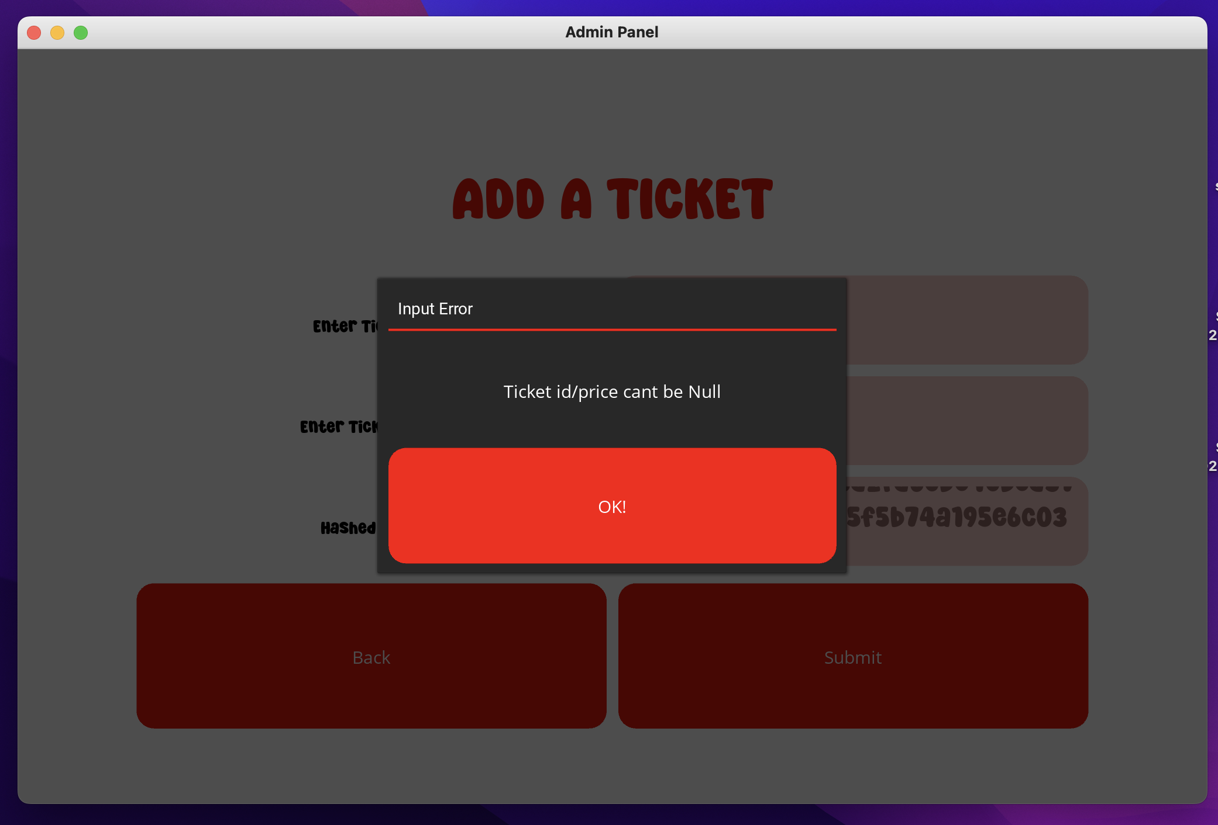
ERRORS HANDLING : NULL ENTRY:

Slide 15
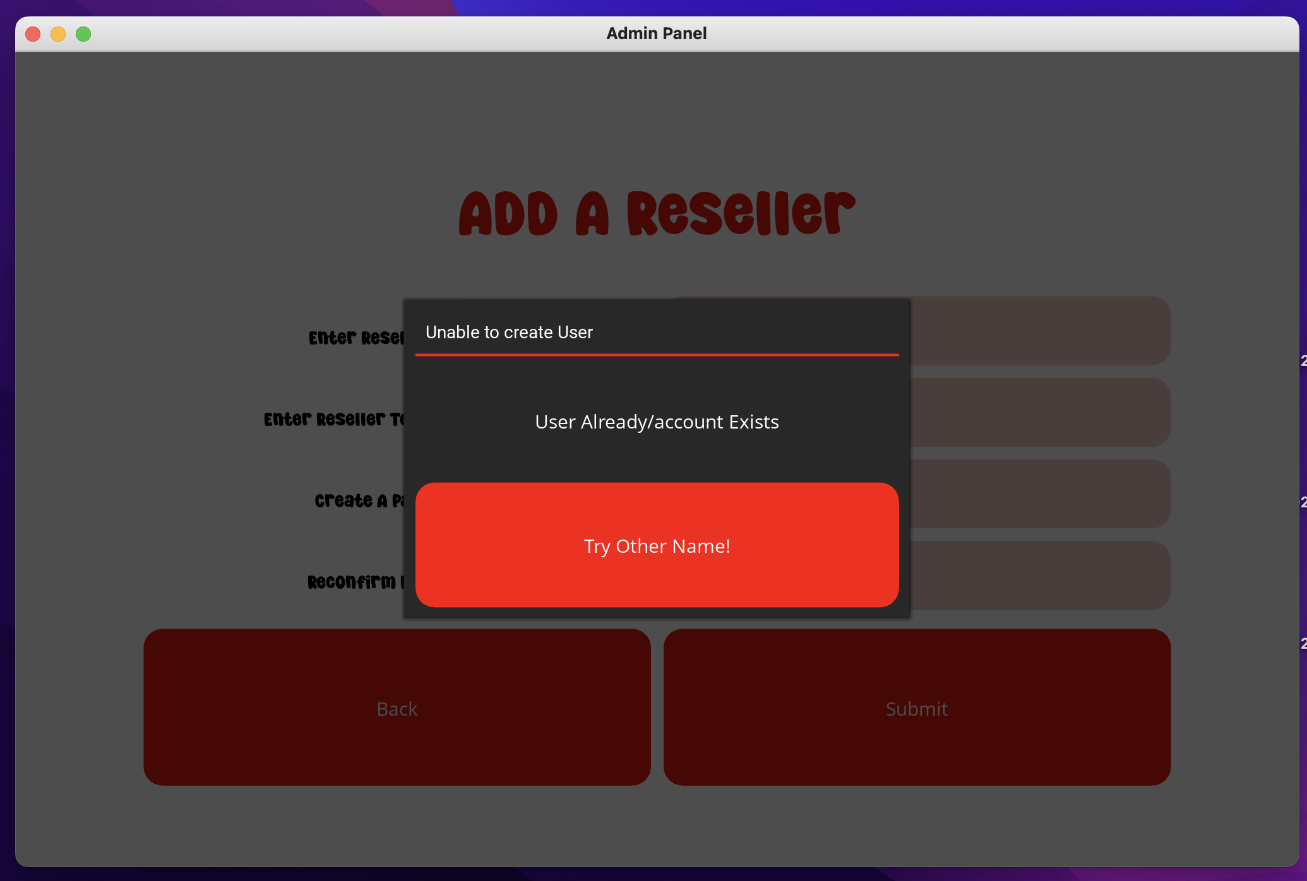
ERRORS HANDLING::DUPLICATE USER

Slide 16
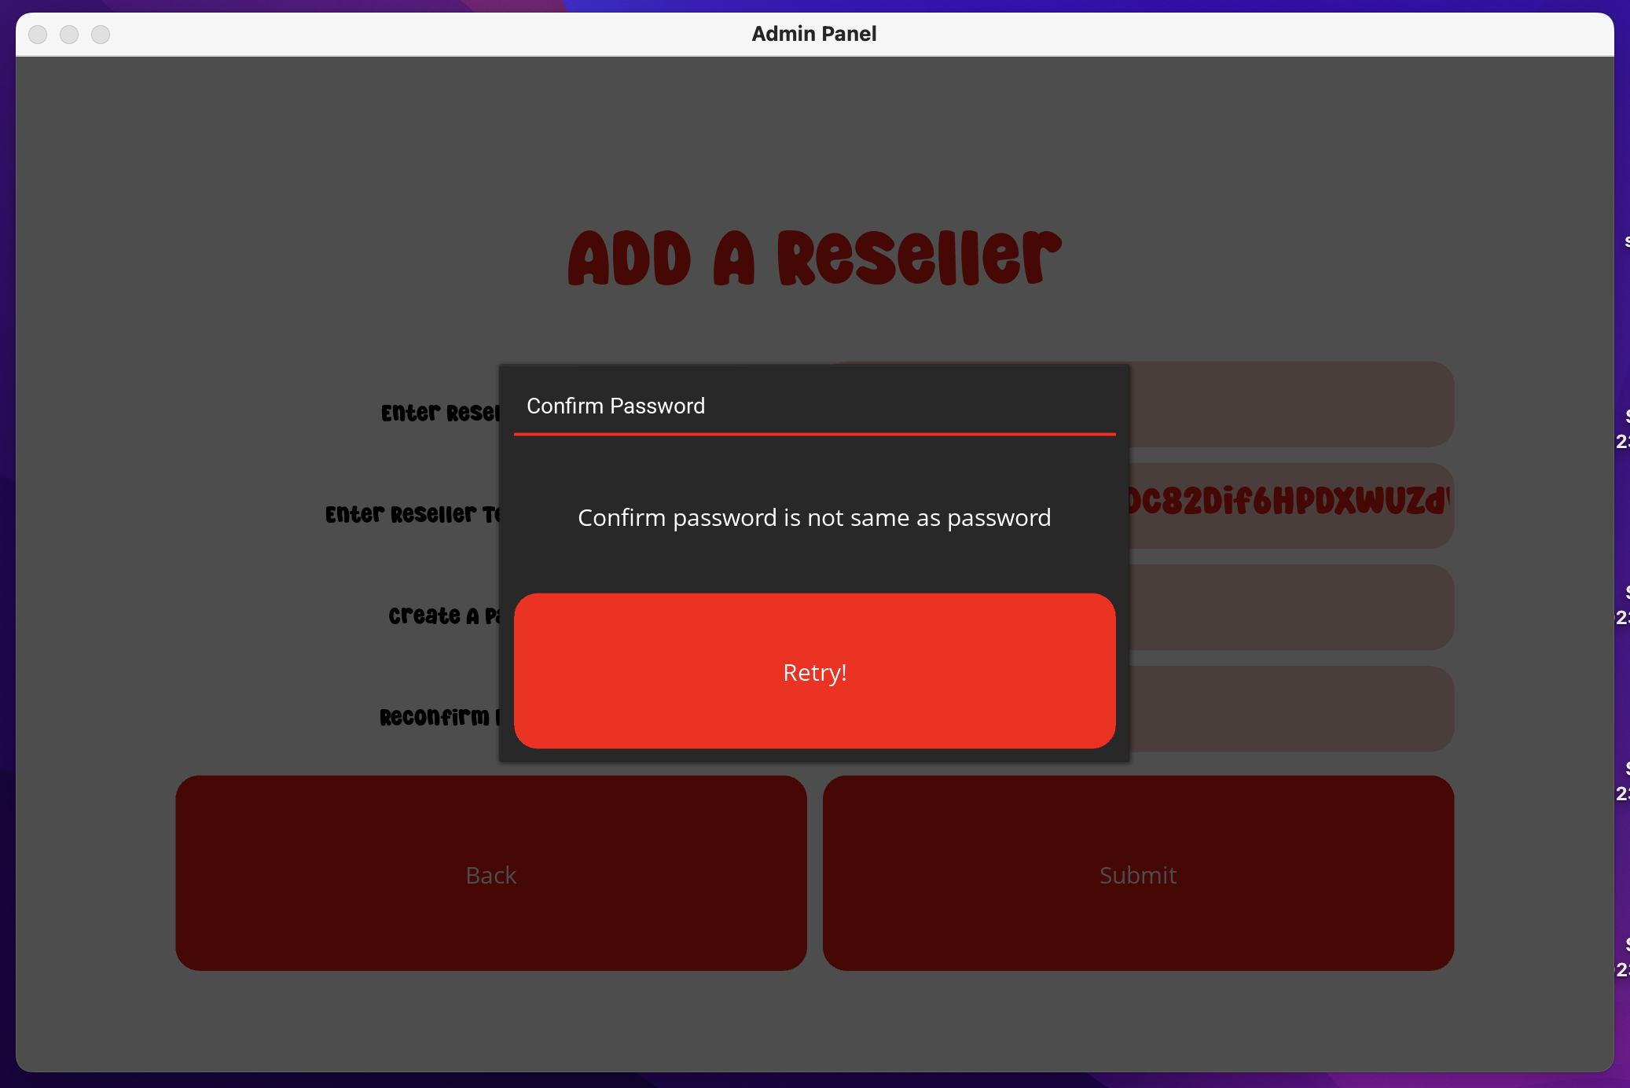
ERRORS HANDLING::FAILED CONFIRMATION

Slide 17
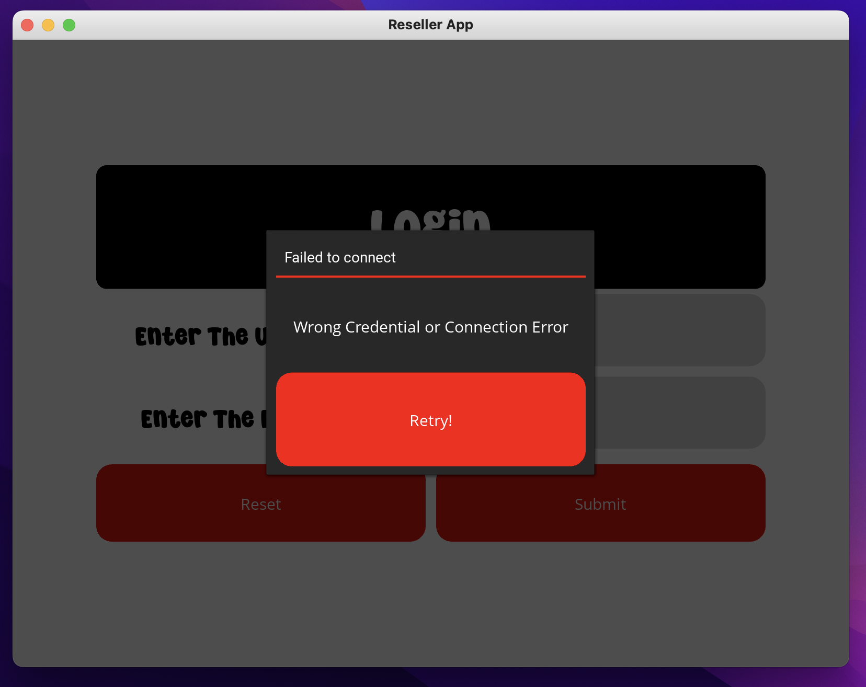
ERRORS HANDLING :INVALID CREDENTIAL:

Slide 18
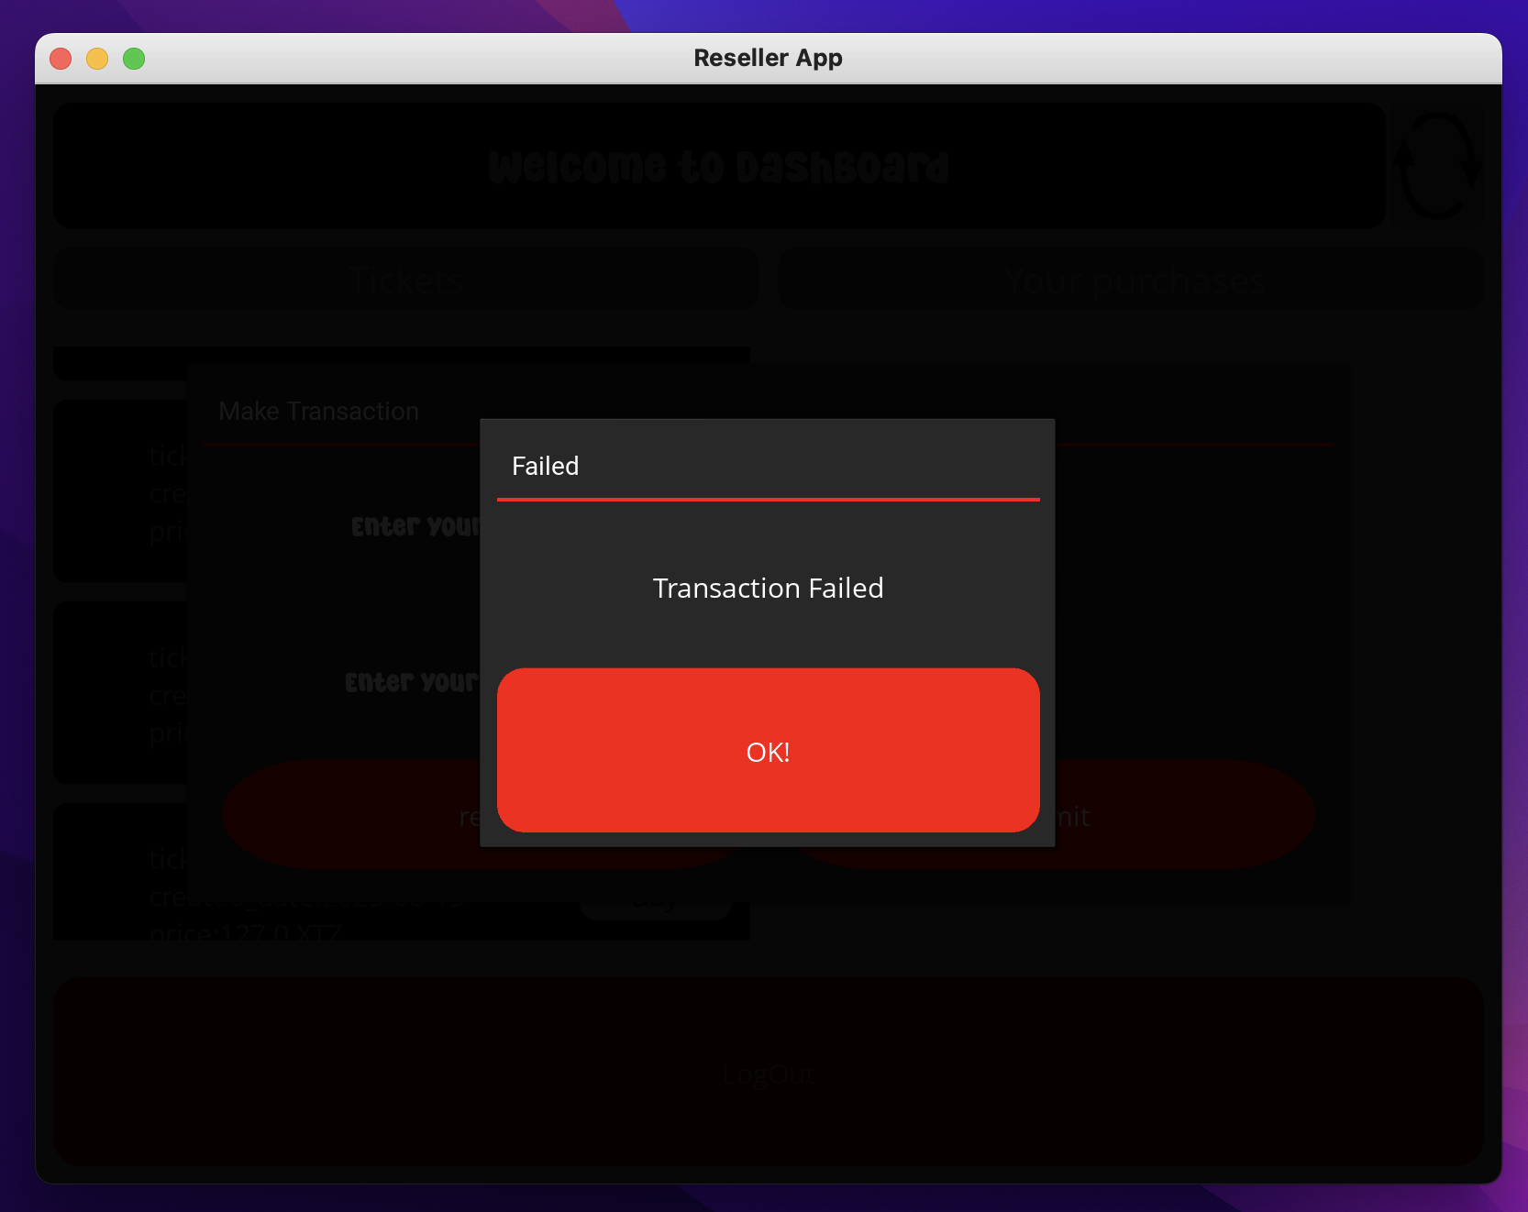
ERRORS HANDLING : TRANSACTION FAILED::

Slide 19
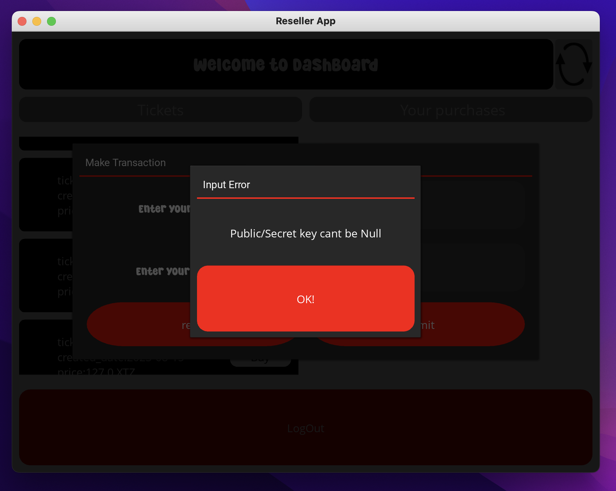
ERRORS HANDLING :NULL INPUT:

Slide 20
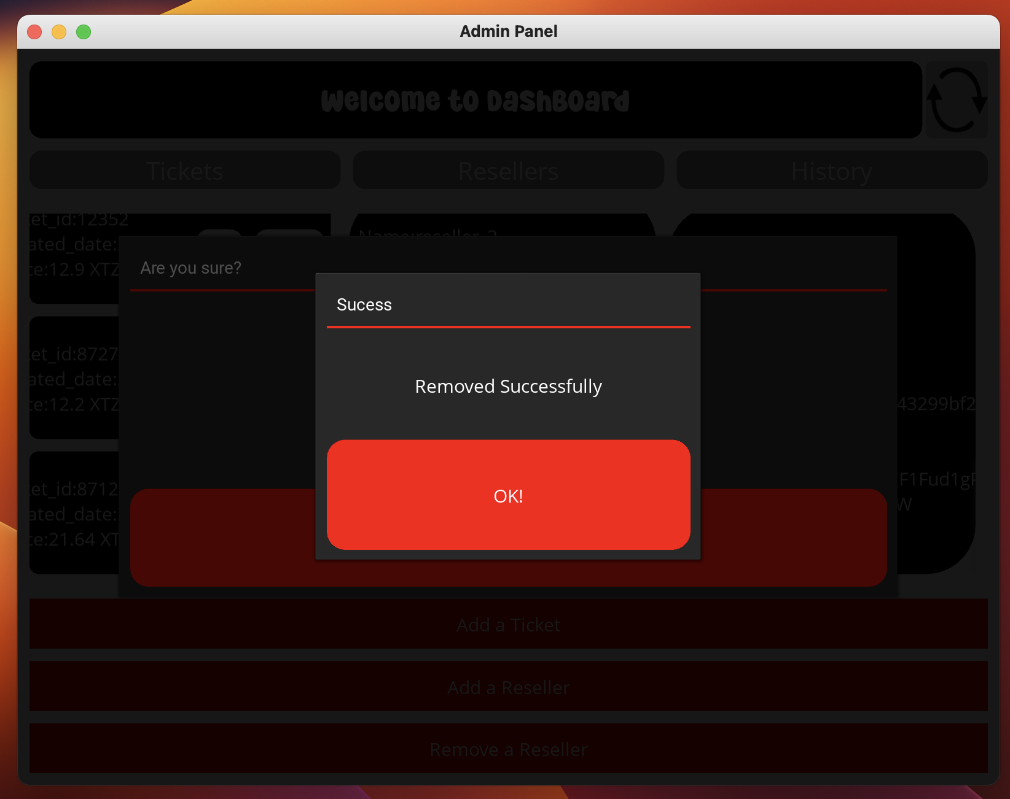
SUCCESS ALERT :REMOVING TICKET:

Slide 21
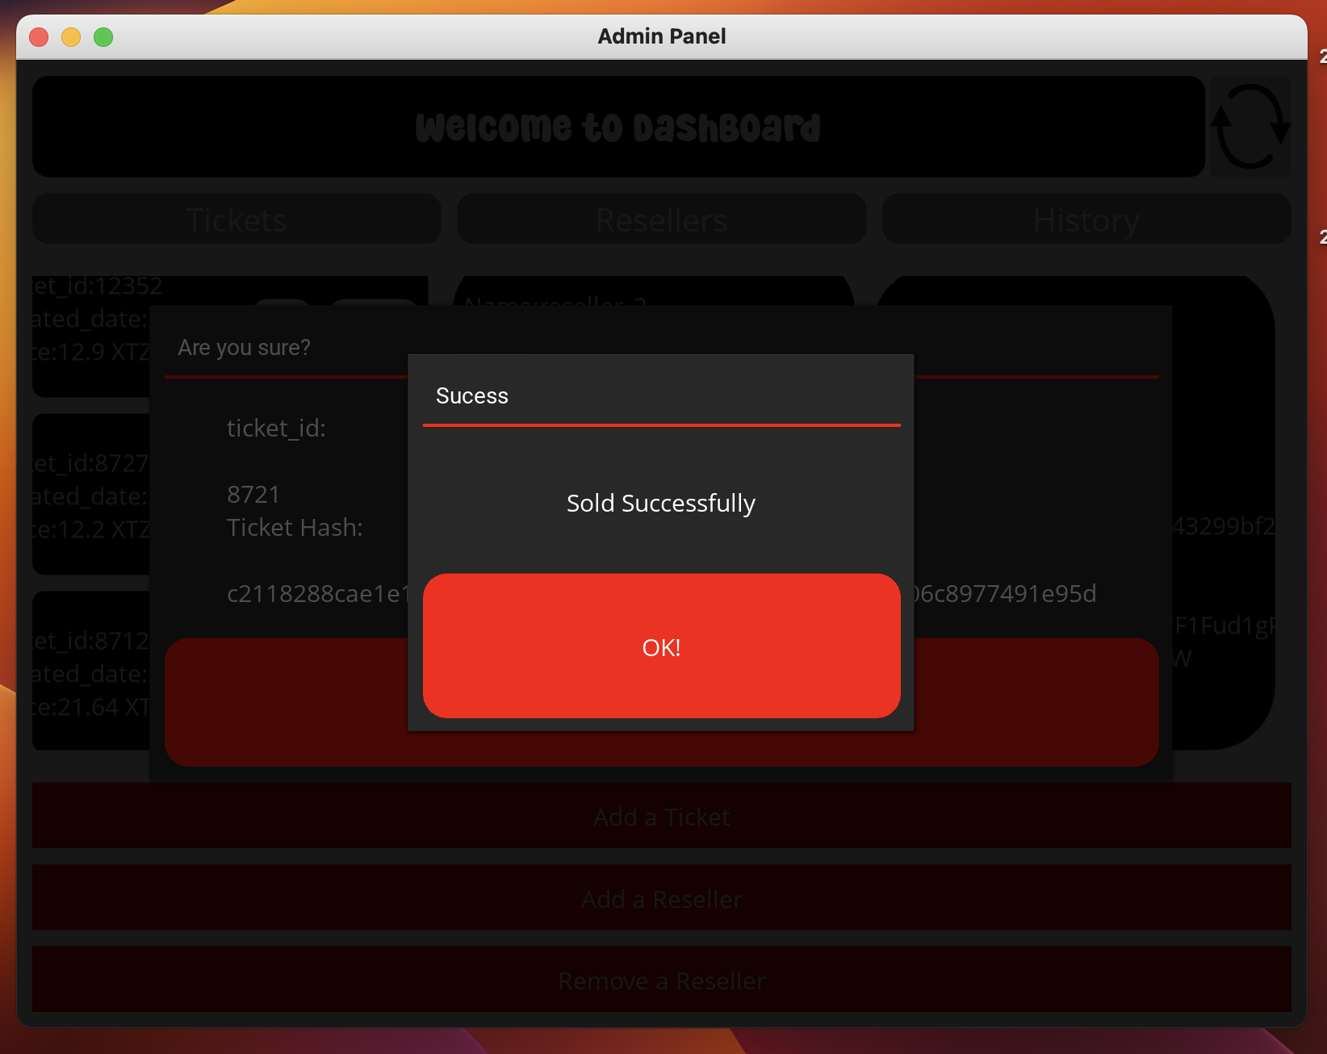
SUCCESS ALERT :SELLING TICKET IN LOCAL:

Slide 22
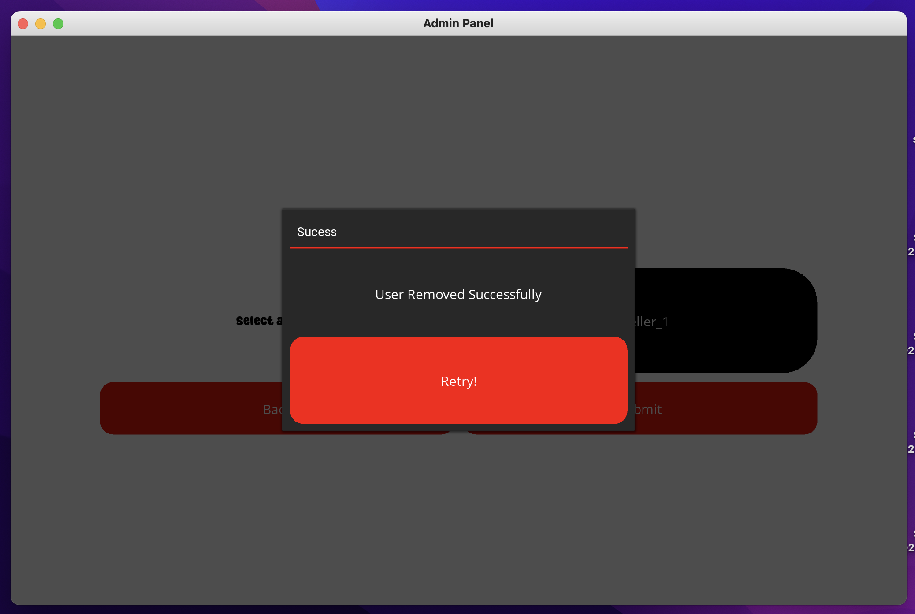
SUCCESS ALERT :REMOVING RESELLER:

Slide 23
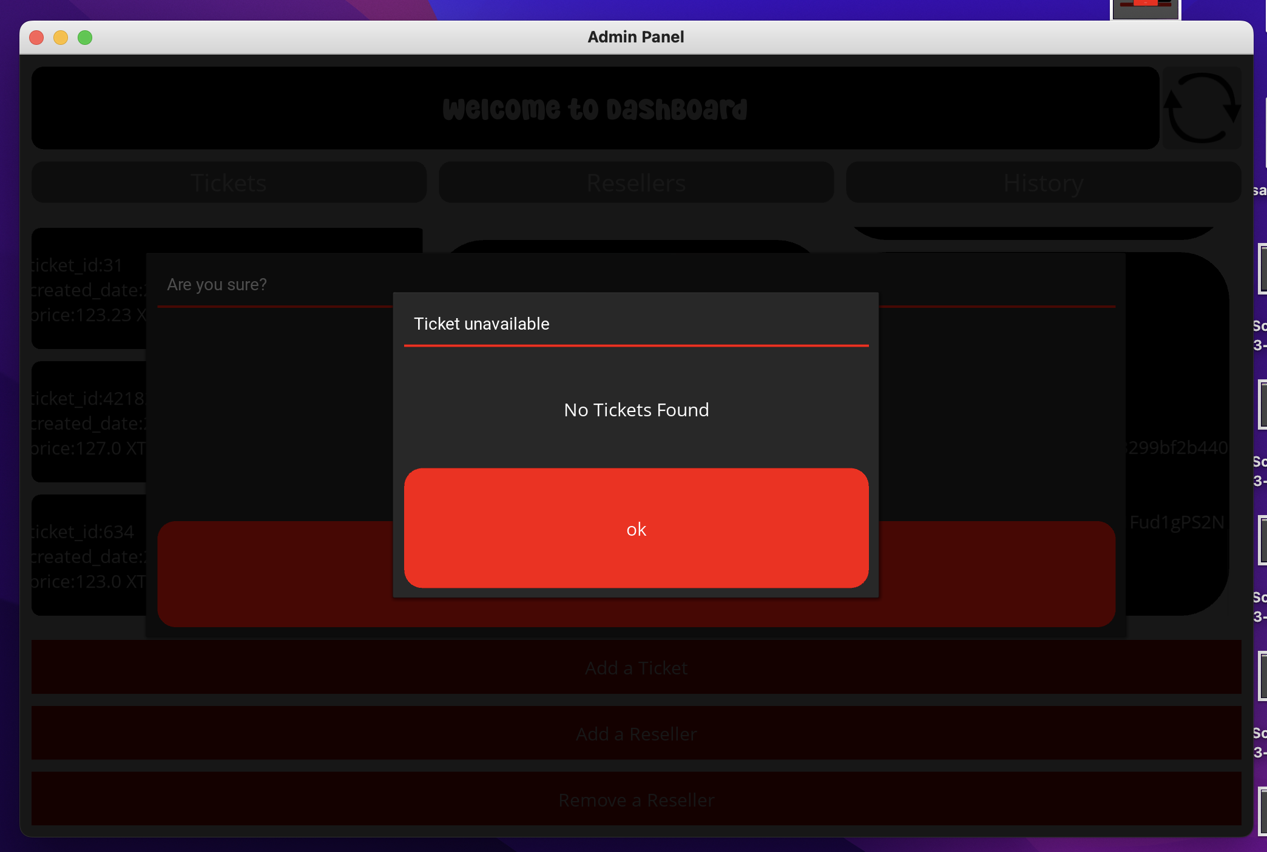
WHAT IF USER DELETE TICKET AND RESELLER MAKING A TRANSACTION?:
ANSWER:
1. while making a transaction on a ticket where a reseller try to buy it,we used a function refersh_connection() which refreshs data every time and for every clicks.

Slide 24
ERROS HANDLING:
ACCOUNTS WITH TEZOS ACCOUNT CAN ONLY BE ADD TO A RESELLERS,
UNAUTHORISED USERS CANT BE ADDED
NULL ENTRY(GIVES WARNING)
FAILED TRANSACTION ALERT
ATOMICITY IN ALL DATA OF DATABASE(NO DUPLICATE ACCOUNTS CAN BE CREATED)
TRANSACTION AND SELLING CANT BE DONE IN SAME TIME, WHERE WE REFRESH EVERY DATA IN THE DATABASE FOR EVERY EVENT.

